Slide 1
Technical Guidelines of the BIPM and CCTF to the participation in UTC
Patrizia Tavella
Aurelie Harmegnies

Slide 2
The reference time scale in each country is (usually) UTC(k) It is a real-time local approximation of the Coordinated Universal Time realized by the laboratory “k” This is realized and disseminated in real-time This is the basis for the legal time and the synchronization in the country Only laboratories contributing to UTC can realize a UTC(k) time scale

Slide 3
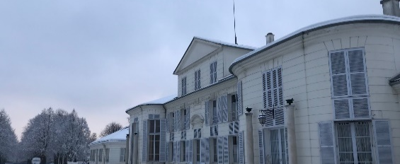
The BIPM computes UTC: a unique, accessible, universal, international reference time scale
We compute the Coordinated Universal Time based on you free running atomic clocks (not UTC(k) ) every months
The definitive reference results are the deviation
UTC – UTC(k)
We compute a provisional weekly rapid solution called rapid UTC
We compute also the Terrestrial Time TT(BIPM) based on the optimal use of Primary Frequency Standards for advanced scientific use

Slide 4
How can we do that?
We need the measures of your free running clocks
We need the measures of your Primary and Secondary Frequency Standards to ensure the accuracy of UTC
We need also the comparison between your local UTC(k) and an external UTC(j)
Comparison obtained by:
GEO
GNSS Common or All in view
GNSS (Integer) Precise Point Positioning
Two Way Satellite Time Frequency Transfer
In future Optical fibers, other space techniques…
UTC(j)
UTC(k)

Slide 5
How can we do that?
We need to ensure that all the time transfer measures used to generate UTC are calibrated.
Calibrations may be carried out by the BIPM, by the RMOs, by individual time laboratories or, in some cases, by other entities such as manufacturers.
All the calibration results are to be documented. We provide a data base containing all the calibration info and reports.

Slide 6
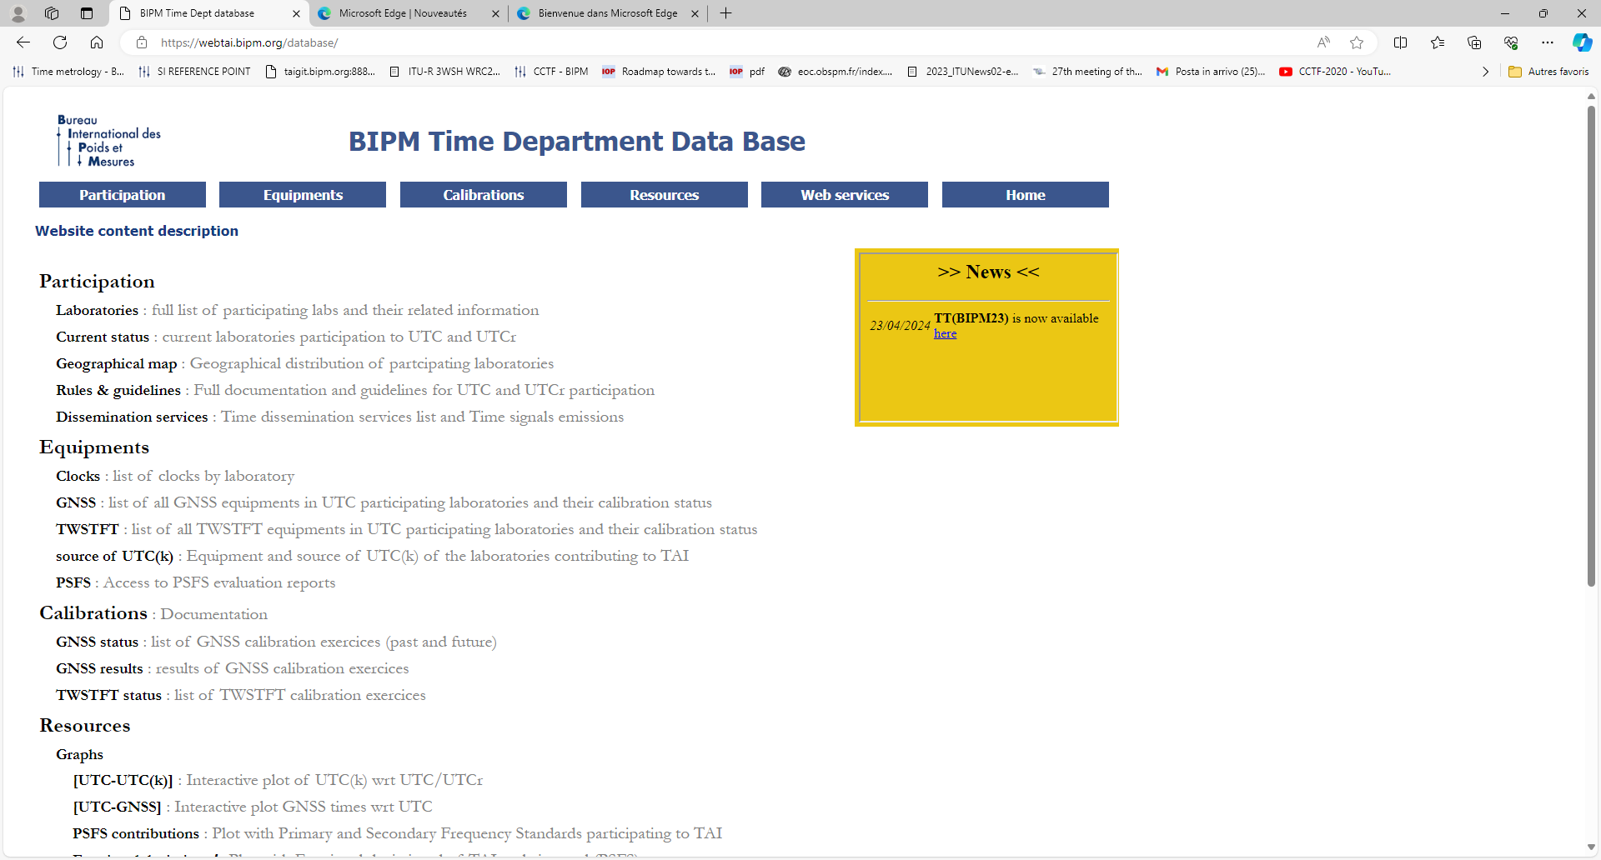
http://webtai.bipm.org/database/
How to enter in UTC?

Slide 7
ccds-rec1993_offset_100ns.pdf (bipm.org)

Slide 8
Mutual Recognition Arrangement
If you want to sell calibration services and issue certificates, you need a step more demonstrating that your national measurements and certificates are equivalent to those of any other country
You need to prove that your national standards are equivalent to others participating to the key comparison, i.e. CCTF- K001.UTC
You need to demonstrate that you work in a Quality system

Slide 9
Technical guidelines for UTC labs (input data) BIPM time department database and FTP server (output data)
Aurélie HARMEGNIES aharmeg@bipm.org
See complete documentation and guidelines:
http://webtai.bipm.org/database/guidelines.html

Slide 10
Outline (1/2) – Input data to be submitted
FTP submission
Expected files (checklist)
Clock data
Clock corrections
CGGTTS
RINEX
HD
TWSTFT
LZ
Primary and Secondary Frequency Standard

Slide 11
Outline (2/2) – Outputs as service
…
UTC products availability
API webservices
API UTC (2020)
API CCL-CCTF ( 2023 )
FTP products
what’s available ?
data file examples
use examples
Consultation portal

Slide 12
FTP submission(@URL: ftp://tai.bipm.org )
FTP/FTPS protocol transfer in FTP ASCII mode (except for RINEX compressed files: FTP binary mode)
Write permissions only in the concerned laboratory folder
UTC submission
Rapid-UTC submission
Fully independant submissions
Recommended :
Daily & automatic
Deadline | 4th day of the following month |  | Day+2 @12:00:00 UTC

Slide 13
Files naming
Type of data | UTC path | UTC filename | UTCr path | UTCr filename
Clock | /data/UTC/xxxx/clocks/ | CDLL__YY.MM_ | /data/UTCr/xxxx/CLOCK/ | CDLL__dd.ddd
CGGTTS | /data/UTC/xxxx/links/cggtts/ | ZZLLmodd.ddd | /data/UTCr/xxxx/CGGTTS/ | ZZLLmodd.ddd
RINEX | /data/UTC/xxxx/links/rinex/ | LLmodoy0.YYo.Z | /data/UTCr/xxxx/RINEX/ | LLmodoy0.YYo.Z
HD | /data/UTC/xxxx/links/rinex/ | HDLLmodd.ddd | /data/UTCr/xxxx/HD/ | HDLLmodd.ddd
LZ | /data/UTC/xxxx/links/LZ/ | LZLLmodd.ddd | /data/UTCr/xxxx/LZ/ | LZLLmodd.ddd
TWSTFT | /data/UTC/xxxx/links/twstft/ modem/region/ | TWxxxxdd.ddd | /data/UTCr/xxxx/TWSTFT/ modem/region/ | TWxxxxdd.ddd
PFS SFS | /data/UTC/xxxx/ clocks/PFS_eval/ | xxxxYYMM.PFS xxxxYYMM.SFS psfs(i)-mjd_mjd.pdf
AUTOMATIZATION AVOIDS TYPOS !!!
ddddd = MJD, xxxx = Lab acronym, LL = 2-characters lab ID, LLmo = GNSS equipment (Rx+Antenna),
YYMM = year last 2 digits(YY)+month(MM), ZZ is the constellation and the frequency+channels code

Slide 14
Files format
ASCII encoding only
No <TAB> character allowed ( for manual entries )

Slide 15
Clock files (Required to have clock weighted in TAI)
Content : [UTC(k)-clock] at 00:00:00 UTC ( values in ns)
TA(k)Code
UTC(k)-TA(k)
ClockCode
UTC(k)-clock
MJD
Value : f9.1 max
Max : 5 data / line
LabCode
UTC : for each standard MJD ending by 4 or 9
UTCr : data for each MJD

Slide 16
Clock files : additional clocks step correction
Any clock presenting a characterized step has to be compensated to keep being weighted… Laboratory has to provide info in the clock data file, using the following format :
Examples:
[UTC(k)-clock]_{before_step} – [UTC(k)-clock]_{after_step}
MJD ClockCode Δphase(ns) Δfrequency(ns/d) Labo LabCode
58110.44 1352909 0000000.0 -0004.400 IMBH 10075
58088.60 1401708 0000000.0 -0000.067 NPL 10017
58098.53 1350761 500.0 0.000 PL 10040
58094.44 1400506 000000.0 21.600 PTB 10005

Slide 17
Common Generic GNSS Time Transfer Standards (CGGTTS) files
Daily observation file :
CGGTTS GPS/GLONASS DATA FORMAT VERSION = 02
REV DATE = 2017-02-03
RCVR = ASHTECH Z-XII3T RT820013901 R2CGGTTS v4.3
CH = 12 (GPS)
IMS = ASHTECH Z-XII3T RT820013901
LAB = PTB
X = +3844059.89 m (GPS)
Y = +709661.48 m (GPS)
Z = +5023129.73 m (GPS)
FRAME = ITRF
COMMENTS = PT02 Cal_Id=1001-2016
INT DLY = 304.5 ns (GPS P1), 319.8 ns (GPS P2)
CAB DLY = 301.7 ns (GPS)
REF DLY = 73.9 ns
REF = UTC(PTB)
CKSUM = 90
PRN CL MJD STTIME TRKL ELV AZTH REFSV SRSV REFGPS SRGPS DSG IOE MDTR SMDT MDIO SMDI MSIO SMSI ISG FR HC FRC CK
hhmmss s .1dg .1dg .1ns .1ps/s .1ns .1ps/s .1ns .1ns.1ps/s.1ns.1ps/s.1ns.1ps/s.1ns
27 FF 58126 000200 780 187 2706 -3612641 +34 22 +57 60 105 251 -81 62 -32 62 -32 46 0 0 L3P 3
16 FF 58126 000200 780 454 3015 -343929 +0 32 -6 30 78 113 -14 32 -3 32 -3 24 0 0 L3P 86
29 FF 58126 000200 780 337 814 -5142813 +68 88 +14 53 47 145 +25 34 -2 34 -2 38 0 0 L3P CB
26 FF 58126 000200 780 721 2603 +2956914 -175 45 -35 17 1 85 -1 36 +28 36 28 13 0 0 L3P CF
Antenna Phase Center coordinates (can be computed by the BIPM if RINEX are provided)
Calibration Identifier from BIPM
Calibration values
[Receiver Reference-GNSS Time]

Slide 18
RINEX files
Format supported (RINEX v2.xx, v3.xx) . Short filename
Daily observation data file only ! (1 file per day /receiver )
Unix compressed (.Z) and possible Hatanaka compression
HD files are required for PPP use
Antenna type and radome in the RINEX header should be valid and referenced in https://files.igs.org/pub/station/general/rcvr_ant.tab or https://files.igs.org/pub/station/general/igs20.atx

Slide 19
HD file (for PPP computation using RINEX files)
Example :
CGGTTS GPS/GLONASS DATA FORMAT VERSION = 02
REV DATE = 2017-02-03
RCVR = ASHTECH Z-XII3T RT820013901 R2CGGTTS v4.3
CH = 12 (GPS)
IMS = ASHTECH Z-XII3T RT820013901
LAB = PTB
X = +3844059.89 m (GPS)
Y = +709661.48 m (GPS)
Z = +5023129.73 m (GPS)
FRAME = ITRF
COMMENTS = PT02 Cal_Id=1001-2016
INT DLY = 304.5 ns (GPS P1), 319.8 ns (GPS P2)
CAB DLY = 301.7 ns (GPS)
REF DLY = 73.9 ns
REF = UTC(PTB)
CKSUM = 90
Do not forget to upload the new file
each time a parameter is modified !
Total delay: 508.662 ns (=2.54 x 304.5 – 1.54 x 319.8 + 301.7 - 73.9)
applied to the PPP solution obtained with NRCan processing on RINEX files

Slide 20
TWSTFT file
File formatted according to ITU-Rec1153.
Example :
** EARTH-STAT LI MJD STTIME NTL TW DRMS SMP ATL REFDELAY RSIG CI S CALR ESDVAR ESIG TMP HUM PRES
* LOC REM hhmmss s s ns s s ns ns ns ns degC % mbar
PTB05 IT02 14 58126 001300 119 0.264718944304 1.453 120 119 0.000000736134 0.020 434 1 274.900 -5.920 0.600 -2 98 1021
PTB05 ROA01 14 58126 001600 119 0.260351698126 0.765 120 119 0.000000736134 0.020 440 1 -31.600 -5.920 0.600 -2 98 1021
PTB05 OP01 14 58126 001900 119 0.264560413657 1.028 120 119 0.000000736134 0.020 437 1 7113.800 -5.920 0.600 -2 98 1021
PTB05 NPL02 14 58126 002200 119 0.264751791632 0.898 120 119 0.000000736134 0.020 450 1 -728.100 0.000 0.000 -2 98 1021
…

Slide 21
LZ file
Only if receiver’s reference is not directly UTC(k) but another Ref
Example :
58082.00301 20225.031
58082.04468 20224.977
58082.08634 20224.073
MJD
UTC(k) – Ref (ns)

Slide 22
PSFS file
Evaluations of PFS or SFS should be reported in monthly file :
Labo PFS PfsCode FreqRef MJD1 MJD2 [Ref-PFS] uA uB uA/Lab uB/Lab Uptime Ref(uB) uB(Ref)
10E-15 10E-15 10E-15 10E-15 10E-15 % 10E-15
xxxx xxxxxxxxxx xxxxxxx xxxxxxx xxxxx xxxxx xxxxxxxxxxxx xxxxxx xxxxxx xxxxxx xxxxxx xxxxxx xxxxxx xxxxxx
NRC NRC-FCs2 1920301 NRC 60399 60414 -1.37 0.18 0.25 0.11 0.00 93.7 T389 0.23
NRC NRC-FCs2 1920301 NRC 60419 60429 -2.07 0.28 0.21 0.30 0.00 57.2 T389 0.23
ADDITIONAL INFORMATION :
Reported by : NRC
Date of report : 07 05 2024
Name of the reporter : Scott Beattie and Bin Jian
END
Comments from the reporter:
Other information:
Since March 1st, 2024 : PDF reports should be uploaded directly on the FTP
Used as documentation, available online after publication of Circular T. Often required to split evaluations period when there are issues on the usual time link ! Try to prevent as much as possible
1ns on link|clock ➔ 4x10⁻¹⁶ on f(PSFS)-f(TAI)

Slide 23
BIPM time department database and FTP server (outputs)

Slide 24
UTC products availability
BIPM Time Department is providing machine readable products and services to support automatized use by end-users (in open-access).
For many years, most data are ASCII formatted and can be read by any home-made script.
Since end of 2018 : more cumulated ‘column free-format’ files to facilitate data treatment
Since Feb. 2020, an API “UTC” provides a subset of products in standard file exchange formats
Since June 2023, an API “CCL-CCTF” provides the list of recommended values of standard frequencies and their validity

Slide 25
API UTC (2020)
https://webtai.bipm.org/api
We developed an Application Programming Interface web service to allow machines and applications to collect data according to custom requests.
The documentation describing the use of the API is accessible at https://webtai.bipm.org/api
It allows retrieving data under TXT, CSV or JSON format.
Currently, only [UTC-UTC(k)], [UTCr-UTC(k)]
and [UTC-GNSS times] are proposed.
The service is planned to provide a larger variety
of data in the future…

Slide 26
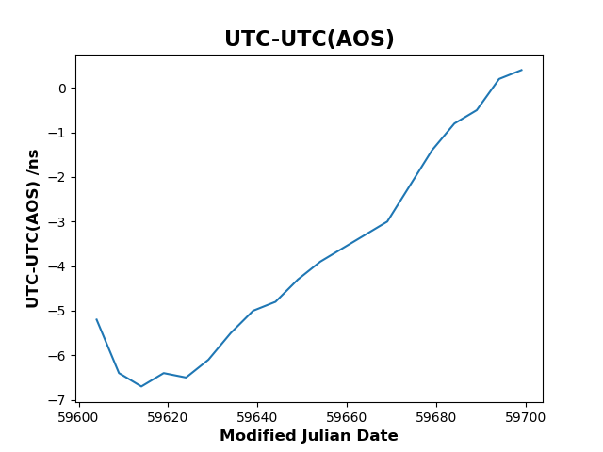
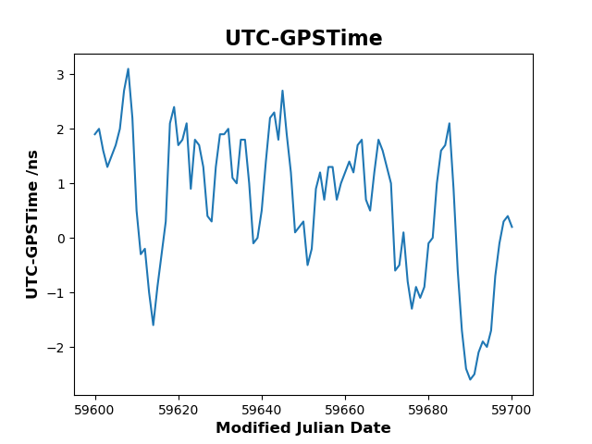
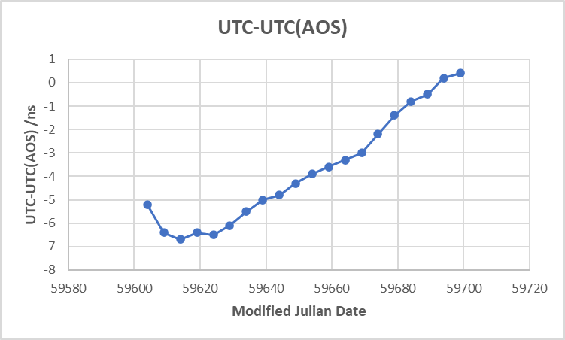
API UTC (2020)
$ wget https://webtai.bipm.org/api/v0.2-beta/get-data.html?scale=utc&lab=AOS
$ curl -k --url "https://webtai.bipm.org/api/v0.2-beta/get-data.html?scale=utc&lab=AOS"
UTC-UTC(AOS)
UTC-GPSTime
Incoming changes in the API with next Circular T:
Input file « UTC-GNSS » splitted into « UTC-GNSS(i) » (no change for user)
Galileo & Beidou added
Uncertainties added
>> No impact on API users <<
standard exchange file formats:
allow use of coding libraries already existing to handle data !
Notes:
26

Slide 27
API CCL-CCTF (2023)
➔ database developped with MeP content.
➔ new CCL-CCTF API developped to support Automatization of Digital Calibration Certificates generation.
Example of call of the API:
« Request of recommended values for standard frequencies »
Strontium (88Sr isotope)
ν = 429 THz​
on 15/05/2024
Machine
answer
Machine request
$ wget -O 88Sr-429THz.xml ‘https://webtai.bipm.org/api/ccl-cctf/v1.0/xml_auto.html?target=88Sr|429+THz&date=2024-05-15’
Open access from June 2023 at https://webtai.bipm.org/api/ccl-cctf !
More details and python tools from NPL can be accessed here :
MeP standard frequencies XML schema :
https://doi.org/10.5281/zenodo.6412020

Slide 28
FTP products – what’s available ?
List of products : https://webtai.bipm.org/ftp/pub/tai/readme.pdf
Available products on ftp2.bipm.org (machine/non-machine readable):
Bulletins
Time scales
PSFS
Equipment diagnostics
UTC-UTC(k)
Circular T
f(TAI)-f(PSFS_{i})
Clock weight
TAI-TA(k)
Rapid UTC
f(TAI)-f(PSFS)
Clock rate
UTCr-UTC(k)
PSFS reports
Clock drifts
Data processed
UTC-GNSS Times
UTC-
$${\text{Broadcast}\text{_}\text{UTC}}_{GNSS}$$
Clocks
Time links
Time transfer
(raw&corrected)
Link comparisons
TT(BIPMYY)-TAI

Slide 29
FTP products – data files examples
( List of products : https://webtai.bipm.org/ftp/pub/tai/readme.pdf )
UTC-UTC(NIST)
UTC-GNSStimes (+ broadcasted)
You can develop your own scripts in any language
to implement diagnostic and monitoring tools
based on these available results in an automated way !
Clock weights
Fractionnal deviation (d)
UTCr-UTC(NIST)

Slide 30
Consultation portal – https://webtai.bipm.org
Guidelines for participation
( file format, rules…)
Status of participating laboratories
Time transfer equipements
Calibrations
Clocks distribution
Plots of the products
UTC-UTC(k)
UTCr-UTC(k)
UTC-GNSSTimes
f(PSFS) vs f(TAI)
+ Access to FTP data and API
Always up-to-date !

Slide 31
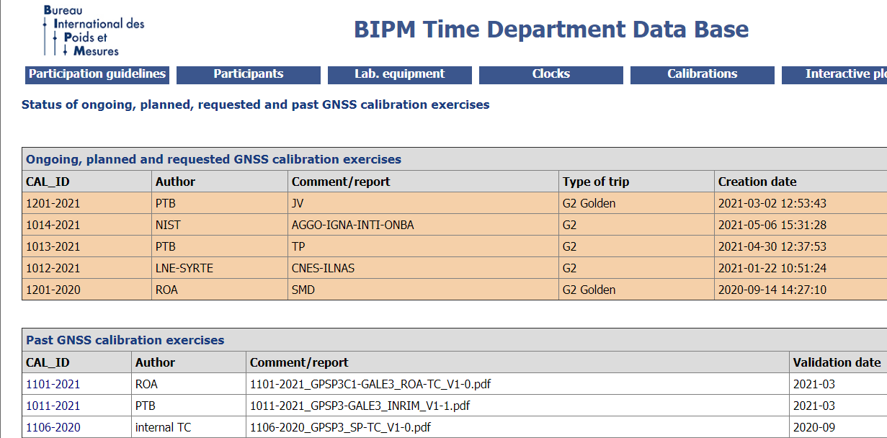
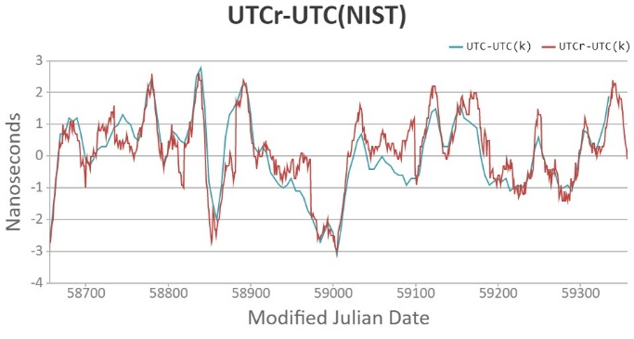
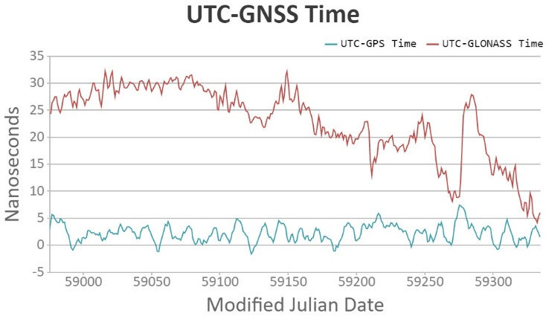
Consultation portal
https://webtai.bipm.org
Available on-demand
dynamic plots:
Calibrations
on-going
Calibrations
listing
GPS
Calibrations results
Evolution for next Circular T
Galileo

Slide 32
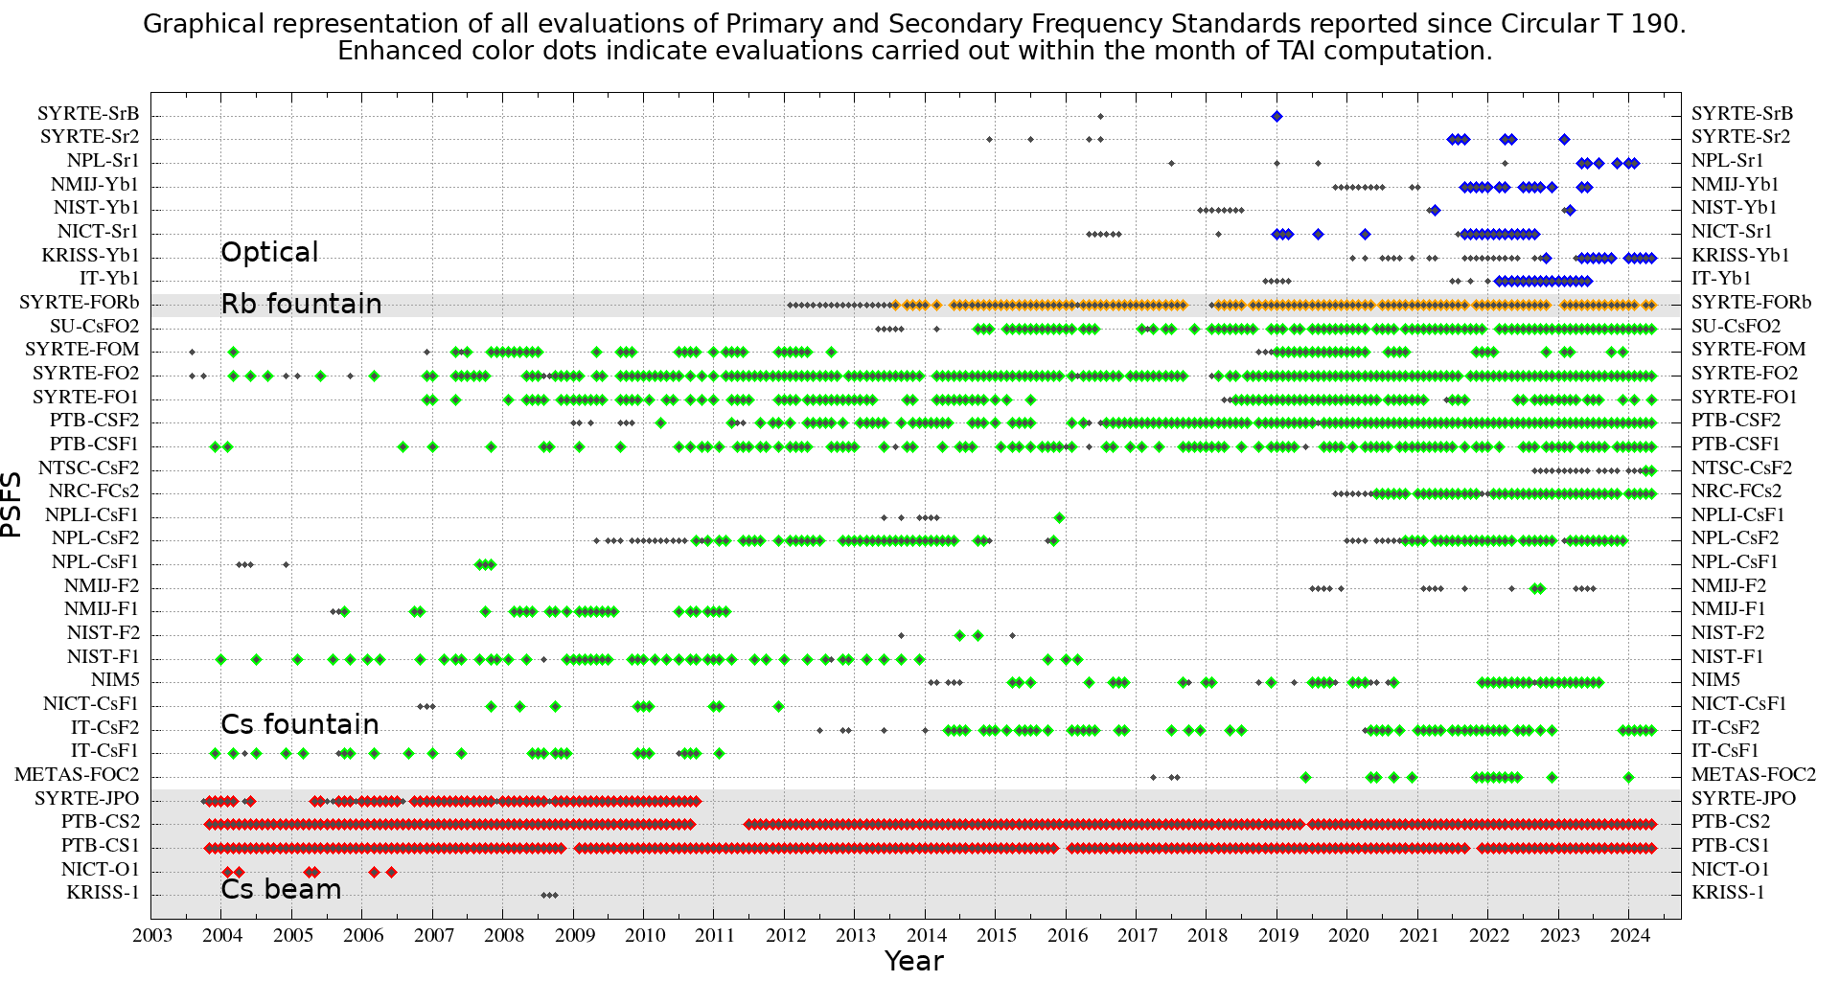
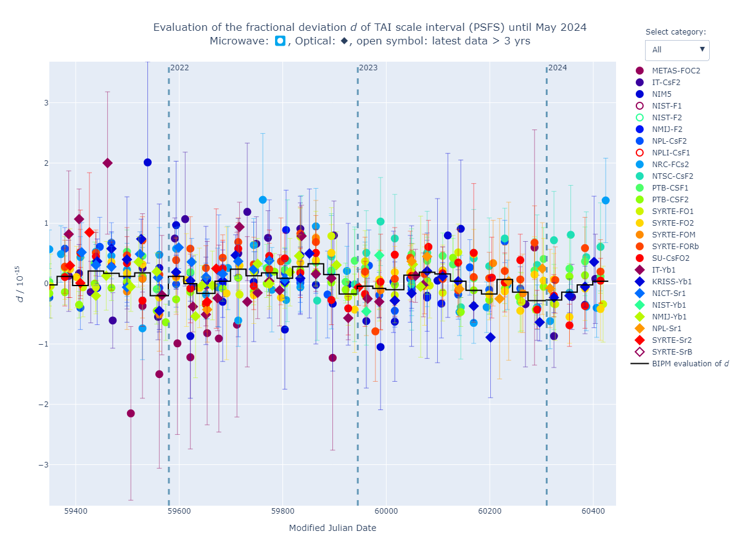
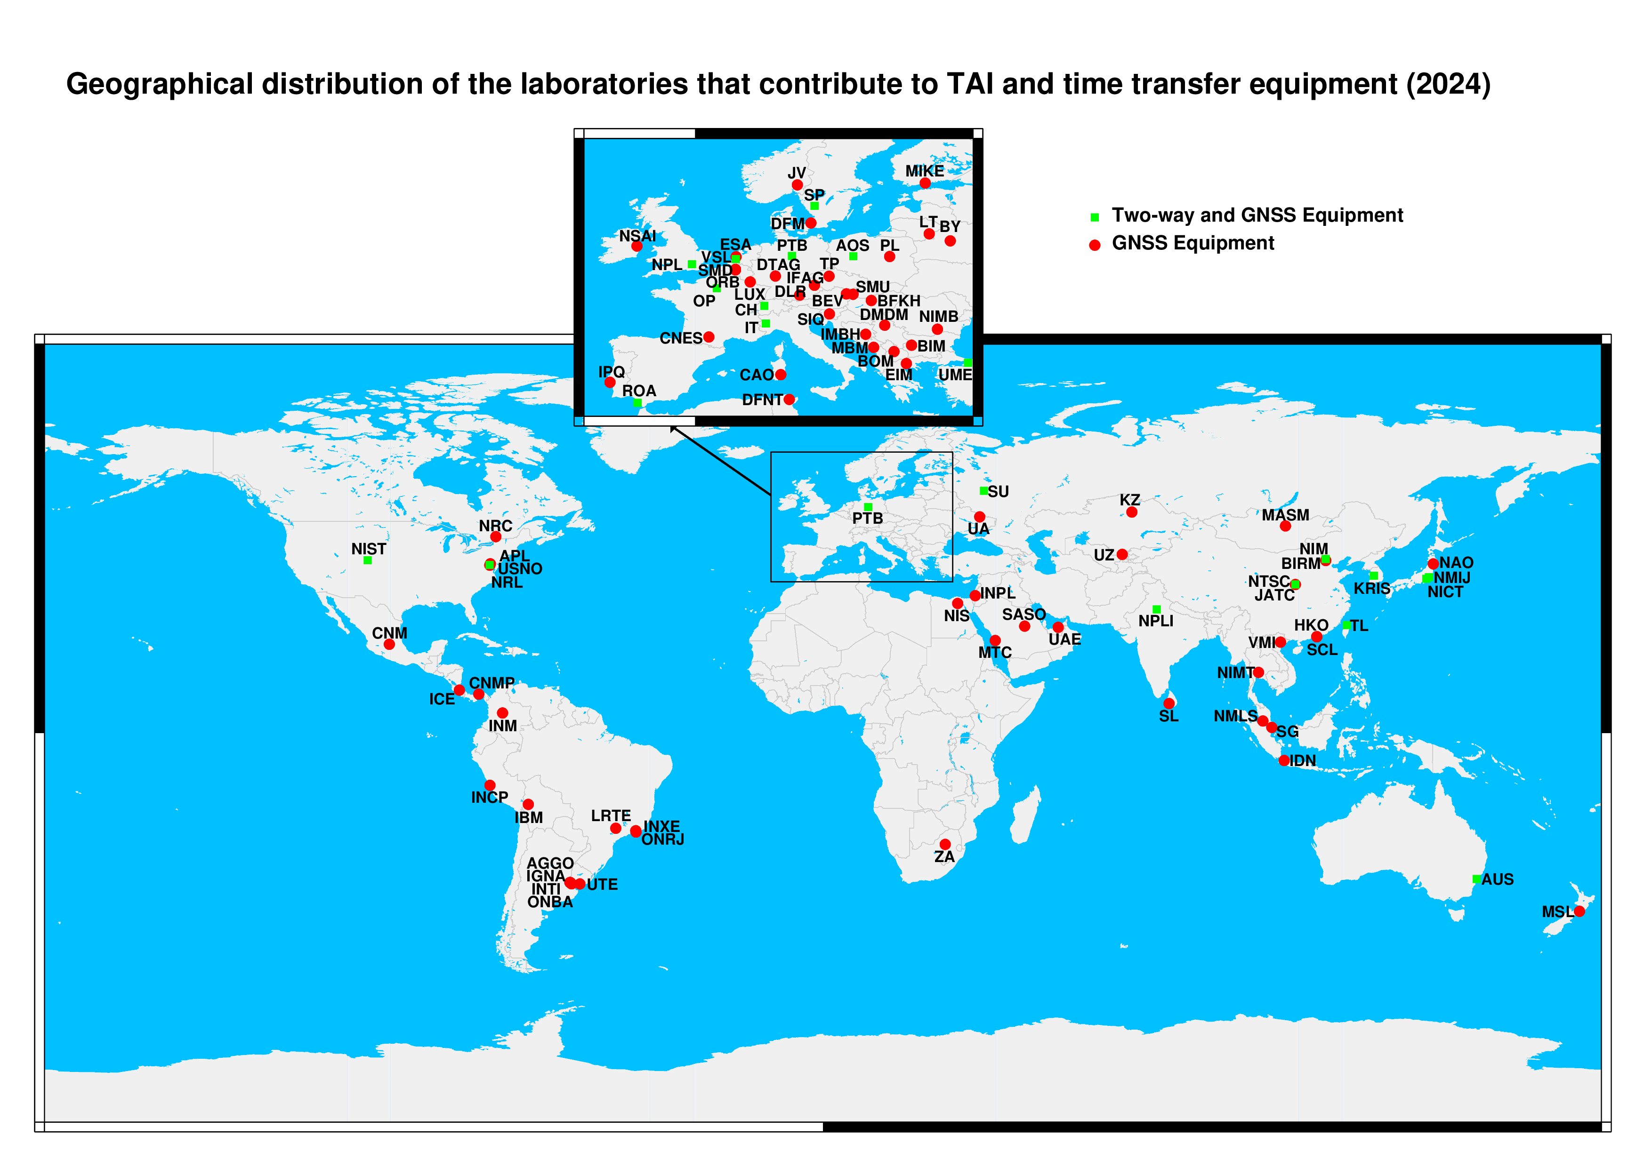
Consultation portal
PSFS contributions

Slide 33
Consultation portal
https://webtai.bipm.org
Equipment inventory of participating laboratories :
GNSS receivers
TWSTFT
Clocks
GNSS (receiver/Antenna) change ➔ need to use new « BIPM ID » for traceability !
Please check your information
and inform us in case of update need !

Slide 34
Consultation portal
https://webtai.bipm.org
Annual updated informations ( from Annual Report )
Time dissemination / Time signals
Equipment in the laboratories ( old Table 4)
Thank you for your inputs for 2023 !
… Only 80% of answer

Slide 35
Thank you for your attention
Reminder : New format for next Circular T ! - Section5 and section1: Not calibrated receivers will appear as NC
- Section 4 : Beidou and Galileo added
(c.f. email of 21/02/2024 for more details)
Contact : tai@bipm.org
Useful links:
BIPM Time Department database website : https://webtai.bipm.org/database/
BIPM Time Department API web service : https://webtai.bipm.org/api
Full technical documentation available at : https://webtai.bipm.org/database/guidelines.html
F.A.I.R. principles: https://www.go-fair.org/fair-principles/

