Slide 1
Core contributions to LOD
Dehant V. ¹, Chicot G. ¹, Laariara D. ², Gillet N. ³, Mandea M. ⁴, Cazenave A. ⁵
Royal Observatory of Belgium and UCLouvain
ULB
ISTerre, Univ. Grenoble
CNRS
LEGOS

Slide 2
1. Coupling at core-mantle boundary
Tidal effects
ΔLOD
Angular momentum transfer
Angular momentum transfer
External geophysical fluids
Coupling mechanisms at core-mantle boundary
Fluid core

Slide 3
Coupling at core-mantle boundary
gravitational interaction
viscosity
topography
global torsional oscillations
pressure
magnetic field

Slide 4
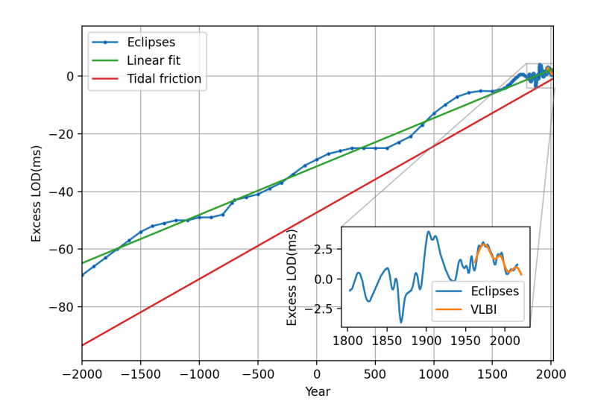
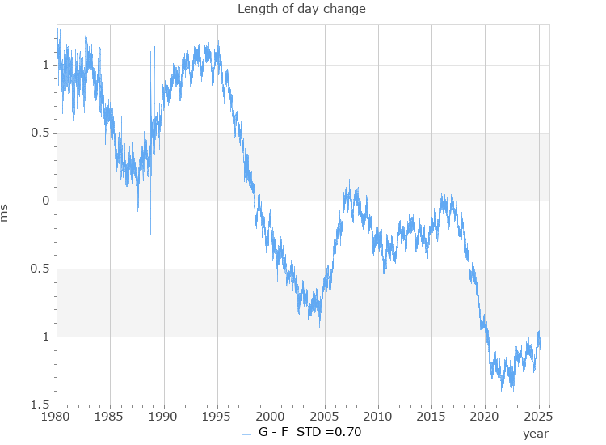
2. Analysis of LOD
IERS website CO4,
Corrected for atmospheric and oceanic effects
ΔLOD (ms)
time

Slide 5
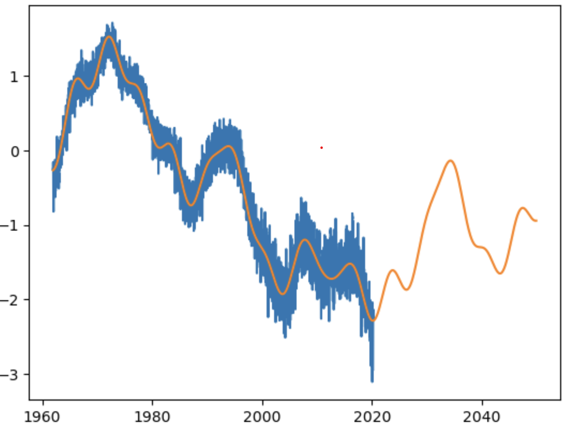
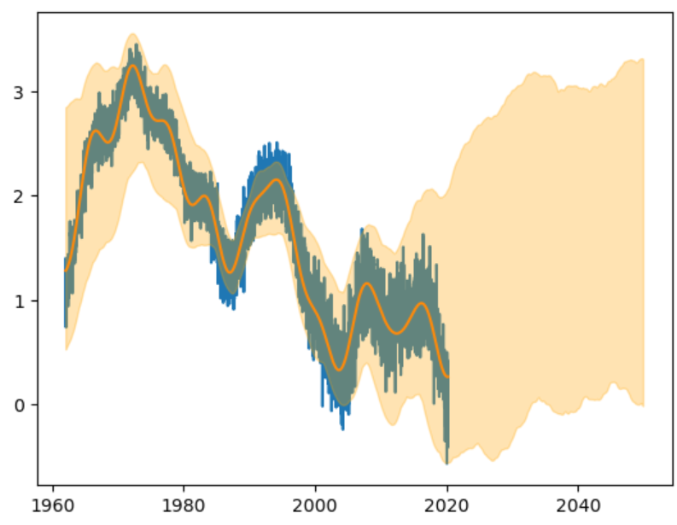
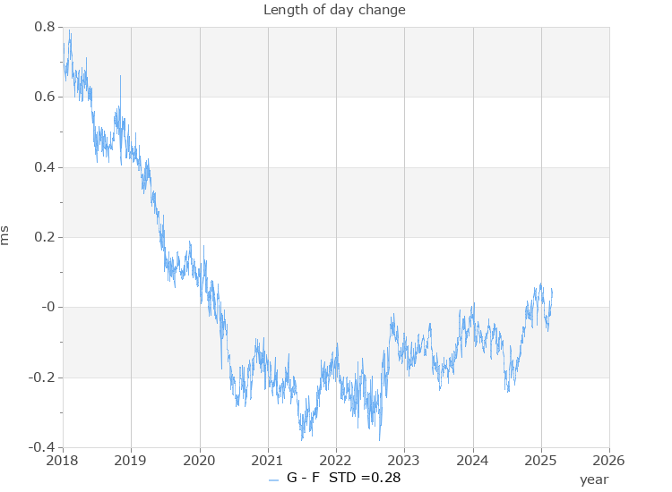
65 yrs,
20 yrs,
30 yrs,
13 yrs,
8 yrs, 5.7 yrs,
10 yrs,
7 yrs,
6 yrs

Slide 6
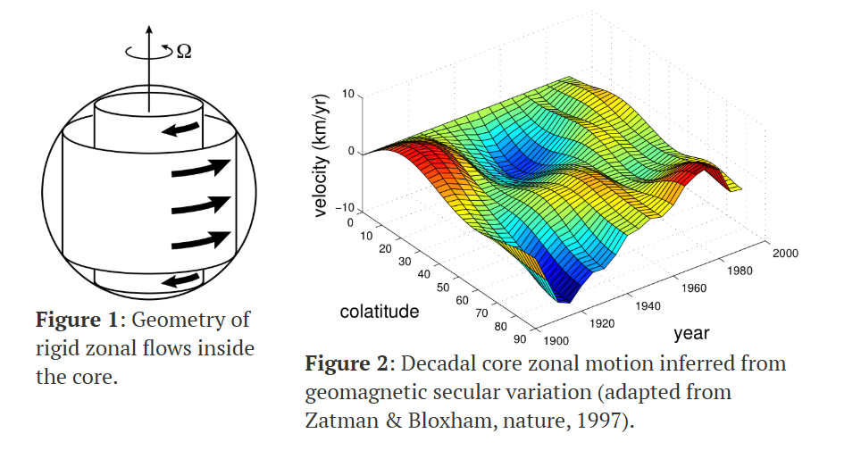
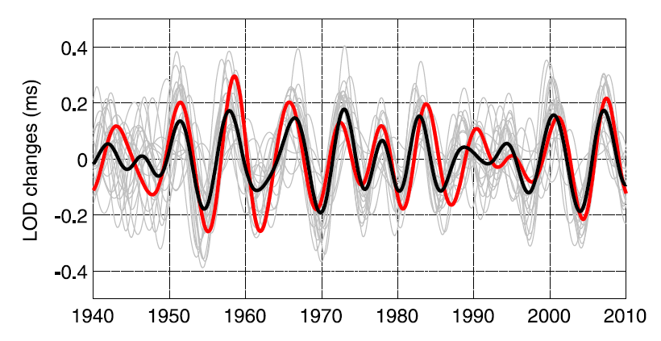
3. contribution computed from Magnetic field and torsional Alfvén waves
(quasi-)geostrophic motions carry angular momentum
Magnetic field
torsional Alfvén waves
ΔLOD
LOD predictions (in ms)
Mean of LOD predictions (in ms)
LOD band-pass filtered between 4 and 9.5 yrs
Dumberry’s website
Gillet et al. 2015

Slide 7
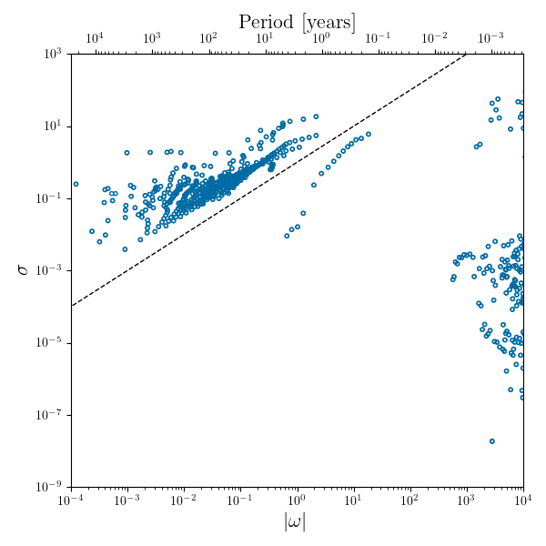
Other modes in ΔLOD?
Kore
Inviscid fluid immersed in a magnetic field
Numerical model where inner core-
core-mantle are fully coupled.
long timescale
Dissipation (ohmic and viscous) in the liquid core and at the core-mantle boundary or inner core boundary
Magneto-Coriolis waves
Tidal forcing in terms of mantle librations, nutations, Length-of-day variations
Torsional waves
conducting layer at the bottom of the mantle
6 years
Inertial waves
8 years
decadal timescale
possible stratified layer at the top of the core
Rotational normal modes such as FCN and inertial modes
diurnal timescale
Presence of a magnetic field
Q=1: Line above which modes are critically damped – make less than one oscillation before dying out
S.A. Triana with Kore (open source)
Similar to Luo and Jackson 2022

Slide 8
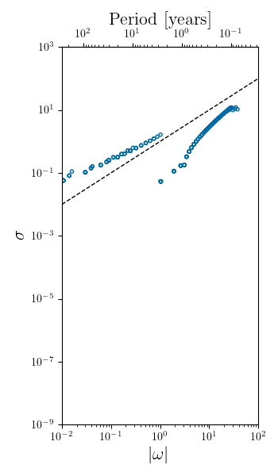
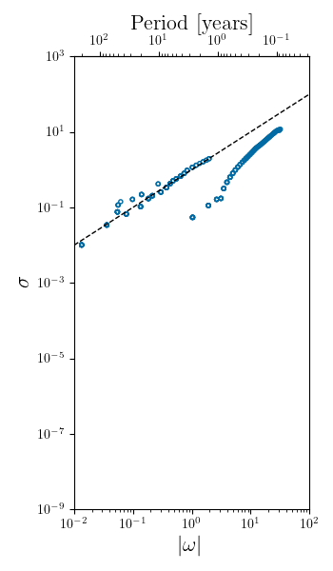
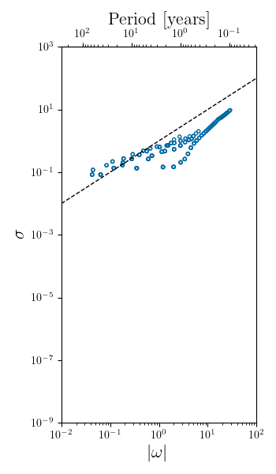
Core modes associated with these timescales
Z-axisymmetric (m=0)  LOD
Below the dashed line!!!
Inviscid
Inviscid fluid immersed in a magnetic field
Viscous
+ thin stratified layer in the core
Viscous
+ thick stratified layer in the core
viscous
S.A. Triana & F. Seuren with Kore
Notes:
The period depends on the assumed Lehnert number (Le) (the ratio between the rotation time scale and the Alfvén wave time scale), which in our (and L&J) case is 0.001.

Slide 9
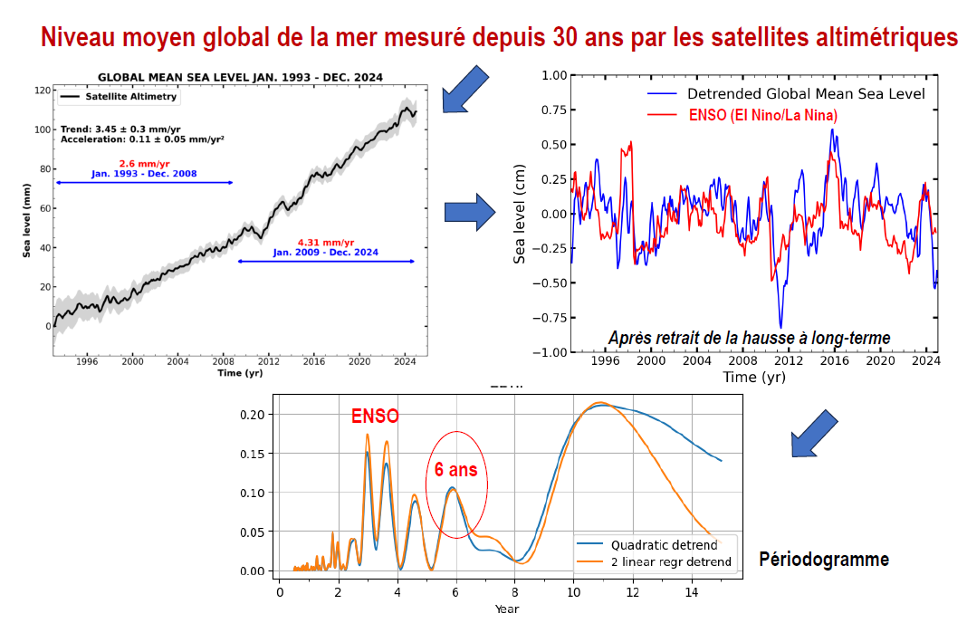
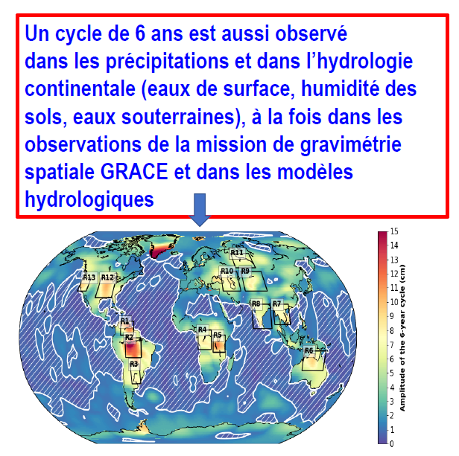
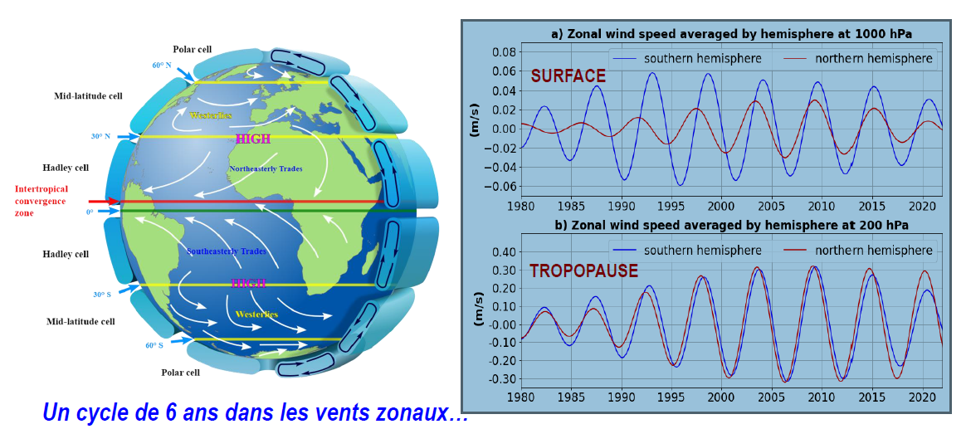
4. The 6-year cycle is everywhere
Earth rotation
Sea level change
Hydrology and precipitations
Atmospheric angular momentum
Core angular momentum
Atmospheric circulation
Surface temperature
Heat in the ocean

Slide 10
Conclusions
LOD observations corrected for atmosphere and ocean show decadal variations,
Decadal LOD variations can be explained using magnetic field and torsional Alfvén waves,
MAC waves need stratification in the core (controversial),
Difficult to predict decadal LOD,
Though the need of a negative leap second cannot be excluded within the uncertainties, it will probably not be the case,
LOD does not seam to continue to decrease, as it increases again.

Slide 11
Acknowledgments
The research leading to these results has received funding from the European Research Council (ERC) under the European Union’s Horizon 2020 research and innovation programme (GRACEFUL Synergy Grant agreement No 855677).
GRACEFUL (GRavimetry, mAgnetism, rotation, and CorE FLow)

