Slide 1
Consultative Committee on Ionising Radiation (CCRI) June 2016
Dr Wynand Louw

Slide 2
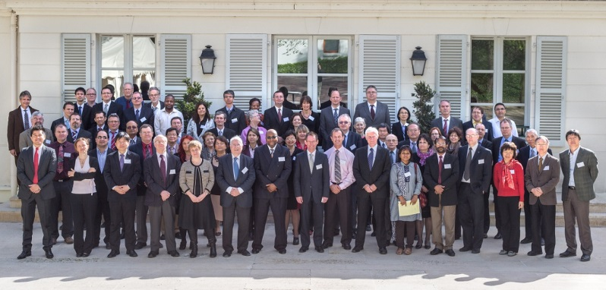
CCRI Members: 35 Observers: 20
CCRI
Comité Consultatif de Rayonnement ionsiants
VISION
2020-2023
Comparison
SIR
Nuclear data
Workshops
Actions
INITIATIVES
2016-2019
Ongoing WGs
2013-2015
WGs
Research
CCRI(I)
Photons, charged particles
CCRI(III)
Neutrons
2009-2012
CCRI(II)
Radioisotopes
Courtesy of K Carneiro

Slide 3
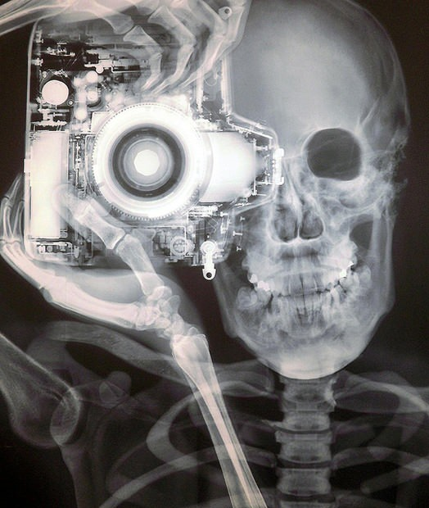
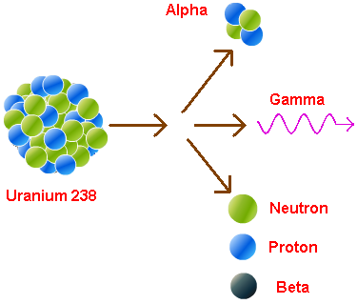
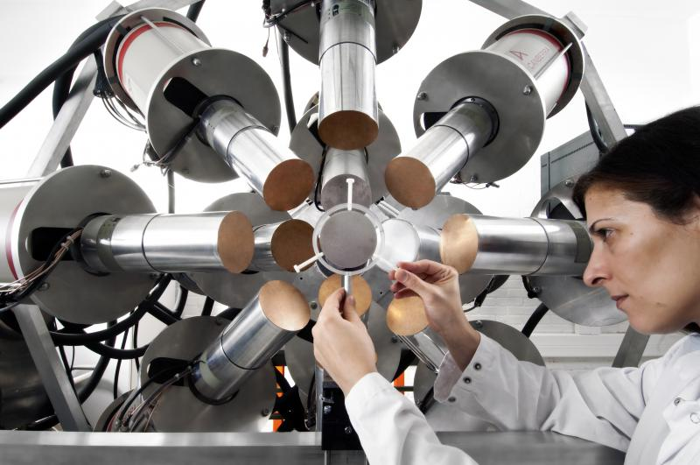
CCRI Sections/Working Groups
Section (I): x and ƴ-rays
Section (II): Radionuclides
Section (III): Neutron Measurements
4026 CMCs in 738 service categories

Slide 4
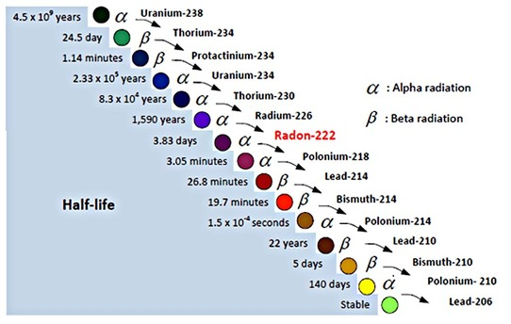
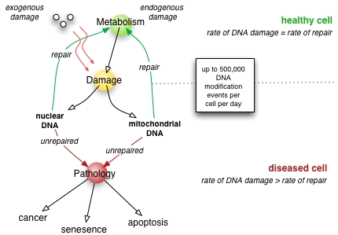
CCRI units?
Main units hinges on the second and kilogramme
Uncertainties on realisation of the s and kg attainable, orders of magnitude lower than in detection of decay events
Nano-dosimetry techniques?
Biologically related Quantities?
Quantity | Unit
Activity of a radionuclide Activity concentration | Bq (s⁻¹) Bq Kg⁻¹
Kerma, Abdorbed Dose Kerma rate, Absorbed dose rate | Gy (J Kg⁻¹) Gy s⁻¹

Slide 5
Activities since last CCU meeting
No proposed changes to the units in use in Ionising Radiation for the revised SI brochure
Other Important Issues:
Letter on “Evidence against solar influence on nuclear decay constants” will be published soon
Monographie BIPM-5 (Table of Radionuclides), Volume 8, ready for publication

Slide 6
CCRI Future Strategy
Maintain the progression from air kerma to absorbed dose to water standards
Establish a long-term strategy for accelerator dosimetry (photon and electron beams) that include the utilisation of existing LINAC facilities
Full extension of the Système International de Référence (SIR) to short-lived isotopes and beta emitters
Work towards new biologically-based quantities
Proton (hadron) dosimetry
Neutron measurements, fully incorporate the National Accelerator Centre (iThemba) of South Africa into the neutron accelerator community by setting up experiment
High resolution MS?

Slide 7
CCRI Activities and Achievements: CCRI(I)
Mammography comparisons are now well established and results have been published in the KCDB since 2011 for the NRC, NMIJ, NIST, PTB and the VNIIM
Current developments in brachytherapy primary standards in the NMIs have generated an increased need for comparisons.
the BSWG(I) was revitalised in 2013 and the protocol and measurement setup for air kerma comparisons of 192Ir high-dose rate (HDR) sources was revised in 2014
Two new comparisons with the NRC and the LNE-LNHB were performed in 2014, and two more are planned in 2015

Slide 8
CCRI Activities and Achievements CCRI(II)
The permanent BIPM service of the Système International de Référence (SIR) for more than 60 gamma emitters, and the SIR Transfer Instrument (SIRTI) for short-lived radionuclides, implemented since 2009 for ^{99m}Tc, used at NIST, NMIJ, KRISS, NIM, CNEA, LNMRI/IRD, IFIN-HH, VNIIM
The SIRTI was extended to ¹⁸F in 2014 in comparisons with the VNIIM, NPL and the ENEA
The extension of the SIR to beta emitters is the object of the trial comparison for ³H, ¹⁴C, ⁵⁵Fe and ⁶³Ni, 14 participant NMIs since 2004
The extended SIR to gamma or beta emitters (and in the future to alpha emitters), and the Measurement Methods Matrix to select appropriate radionuclides that efficiently demonstrate the capability to measure other nuclides of similar (or inferior) complexity will significantly reduce the need for CCRI(II) comparisons organised by the NMIs

Slide 9
CCRI Activities and Achievements: CCRI(III)
The delays in completing comparisons for neutron measurements are being reduced by using a single central facility whenever possible, as in the case of the comparison on monoenergetic neutron fluence
However, this does not permit testing of the capability of participating laboratories to produce a suitable neutron fluence
Although some NMIs have expressed an interest in personal dose equivalent measurements, there remain a number of problems related to the definition of the quantity in terms of a parallel beam
The revision of neutron CMCs could be done during the CCRI(III) meetings which gather most of the laboratories performing neutron measurements, since this will allow the timeline for approval to be reduced

