Slide 1
Developing our Metadata: Technical Considerations & Approach
Ray Plante
NIST
…don’t worry ;-)
or How we concentrate on concepts

Slide 2
Creating & Curating Records
Descriptions of an NMI’s data assets will be stored in a registry
An NMI will be able to create and update their own records
Can operate own registry or use a remote one
NIST can provide a registry application, or NMI can create or adapt their own
e.g. to connect their local infrastructure
Options will be described tomorrow

Slide 3
Collecting Records for Searching
Propose using OAI-PMH as the protocol for exchanging metadata
Community standard
Widely used (including in the Virtual Observatory)
Well supported by open software
Searchable Registry
Wants to collect records for all data resources from all NMIs
Uses OAI-PMH to pull the records from the NMIs
Provide a means to search
Web page GUI
Scriptable (REST) interface

Slide 4
NMI Registry Federation
Registry
Of Registries
NMI
Dataset
NMI
harvest
harvest
(pull)
(pull)
Database
Publishing
Registry
Full
Searchable
Registry
Full
Searchable
Registry
harvest
Portal
(pull)
Data Repository
manual
entry (push)
Database
Publishing
Registry
NMI
Dataset
Dataset
NMI
Database
Portal
Dataset
Portal
Dataset
Dataset

Slide 5
Record Format
We will eventually decide the record encoding format
Leading choices: XML, JSON, JSON-LD
Choice is not critical
At NIST, we have been developing conventions for defining schemas in all forms with mechanisms to convert between them as needed.
Is there an opportunity to leverage local infrastructure, tools by picking a particular format?
Today, we want to concentrate on…
What kinds of data resources we want to discover
What concepts are needed to describe them
Which concepts are important for discovering resources through a query
What information we need in order to access and use them

Slide 6
Defining a Schema
Schema = the set and organization of the terms (representing concepts) that we will use to describe our data resources
Schema framework = the techniques and patterns we use to define our schema
Key requirement: Extensibility
Allows us to evolve schema with extensions add new terms as needed
Don’t need to solve the entire metadata problem today (or ever)!
Introducing extensions must not break existing systems
Successful strategy for extension demonstrated in the Virtual Observatory

Slide 7
What do we want to find?
Each record will describe something that we want to be able to discover
Datasets
Standard Reference Data, Reference Data, Data associated with publications, …
Databases
Portals and web sites
Other tools and services
Our Member Institutes
Participating Registries
Our discussion of sample queries will help tease this out

Slide 8
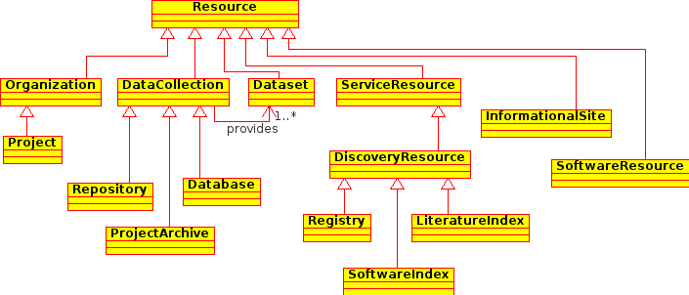
Different types of resources
Resource = something we want to find
We expect to have a set of metadata attributes that are common to all resources
We can add additional metadata to describe specific kinds of resources
A model being developed for the materials science community

Slide 9
Kinds of metadata
Identity -- how we recognize it
Curation -- who is responsible
Content -- what it is about
Access -- how to get at it
Applicability -- how it applies to different domains
Examples: Physics, Chemistry, Biology, Materials Science
Can have multiple entries, each containing metadata specific to a different domain

Slide 10
Strategy
Collaborate on a demonstration
NMIs can participate at whatever level they are able
Refining the metadata schema: conceptually or technically
Software implementations
Leverage on-going registry development at NIST
What do we want to find and how
Sample queries
Issues

