Slide 1
News from the CIPM
Joachim Ullrich, Chair
25th meeting of the CCU, 21 - 23 September 2021

Slide 2
2 News from the CIPM / 108 / 2019
2 News from the CIPM / 109 / 2020
→ Membership application
…a warm welcome!

Slide 3
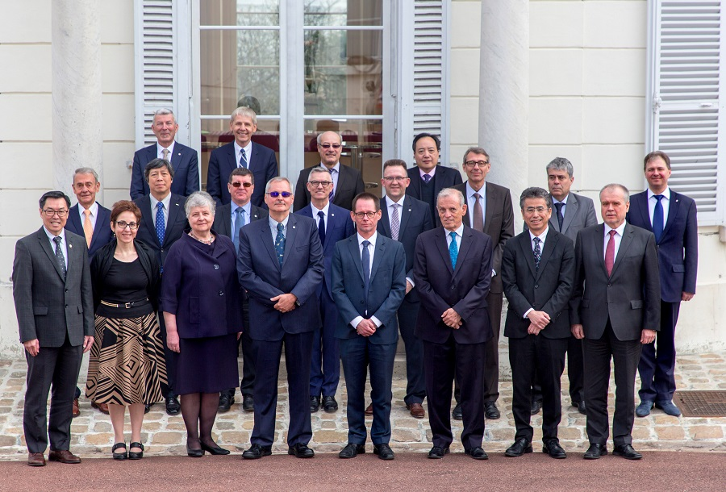
2. News from the CIPM / 108 / March 2019
Decisions of interest

Slide 4
2 News from the CIPM / 108 / 2019
Decisions of interest
The CIPM takes responsibility through its CCU
A structured input into the JCGM
→ TOP 8 today
Possible CGPM resolutions

Slide 5
2 News from the CIPM / 108 / 2019
Decisions of interest
→ TOP 7
→ TOP 6

Slide 6
2 News from the CIPM / 108 / 2019
2 News from the CIPM / 109 / 2020
Decisions of interest
→ TOP 10.2

Slide 7
2 News from the CIPM / 108 / 2019
Decisions of interest
→ Digitalization comes into the focus

Slide 8
2 News from the CIPM / 108 / 2019
2 News from the CIPM / 110 / 2021
Decisions of interest
→ TOP 10.1

Slide 9
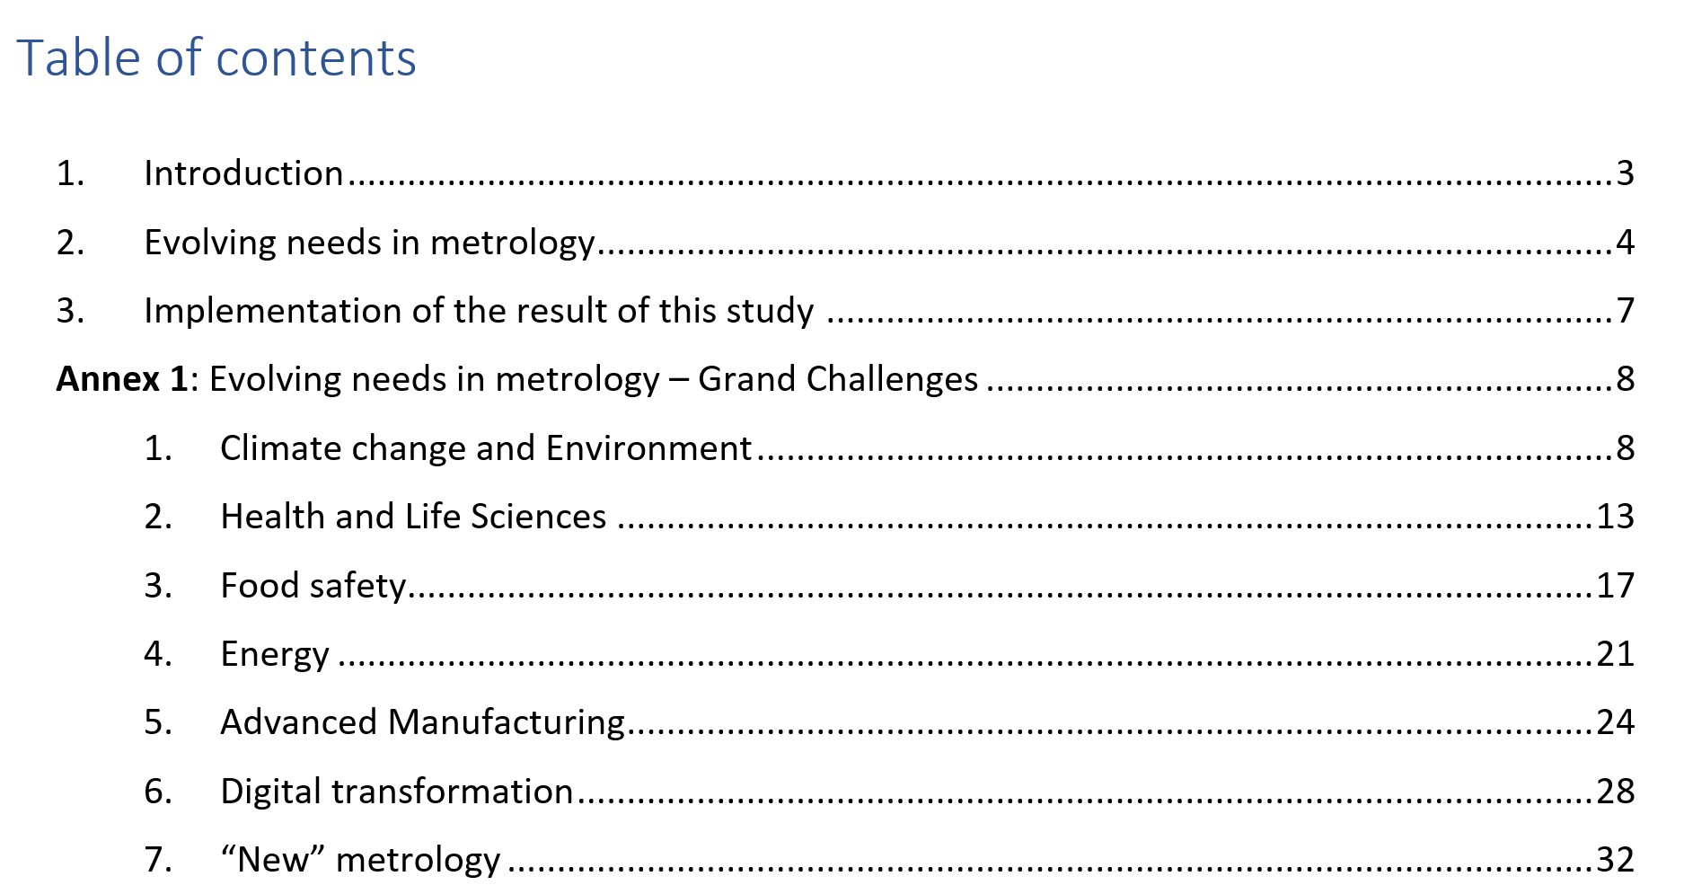
2 News from the CIPM : Draft Resolutions
Decisions of interest
→ TOP 10.1
→ TOP 10.2
→ TOP 7

