Slide 1
10.2 Update on the
CIPM Task Group
SI Digital Framework
Joachim Ullrich, Chair
25th meeting of the CCU, 21 - 23 September 2021

Slide 2
Metrology for the Future
by 2050 about 50 % to 80 % of the population live in cities
What will cities look like?
How will the supply work?
What measurements and metrology will be needed?
What Quality Infrastructure will be needed:
→ How can we guarantee high-quality and reliability
in complex interlinked systems?
Source: https://pixabay.com/de/photos/stadt-panorama-smartphone-steuerung-3213676/

Slide 3
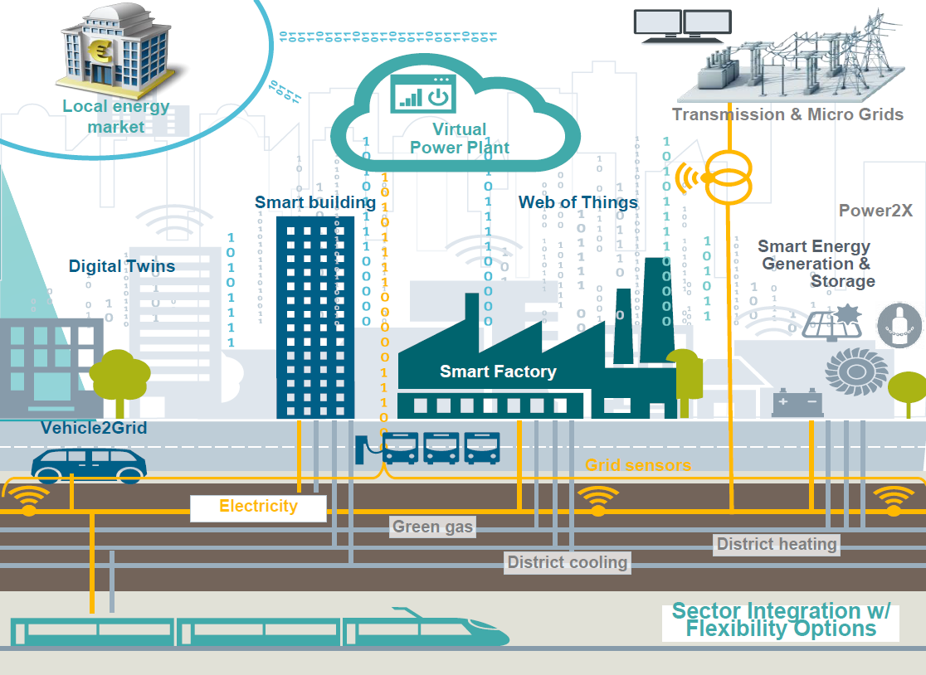
Metrology for the "City of the Future"
Smart Energy Grids
Photovoltaics
Wind Energy
5G
Smart Building
Smart Factories
Batteries
Charging Pole
Smart Mobility
Electricity
Water
Green Gas
Cooling
Heating
Thousands of sensors: metrology is essential!
Source: Siemens

Slide 4
Systems Metrology of the Future
Photovoltaics
Wind Energy
Electricity
Energy Grids
Charging Pole
Batteries
5G
5G … 6G…
Smart Building
Measurement Data
Heating
Digitalization
Green Gas
Water
Smart Mobility
Cooling
Smart Factories
The very basis is measurement data!
Usually expressed in units of the SI!

Slide 5
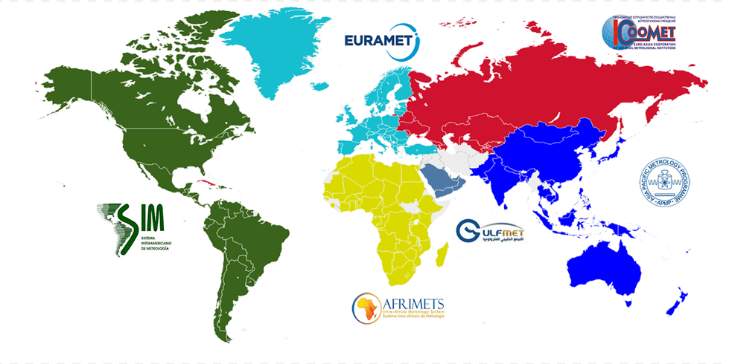
The Metre Convention and the SI
signed in 1875
accreditation
~ 65 000 laboratories are accredited along
ISO/IEC 17025 requesting traceability to the SI
standardization
metrology
102 Member, Associated States and Economies
97.6 % of the World’s GDP
Basis for the Quality Infrastructure

Slide 6
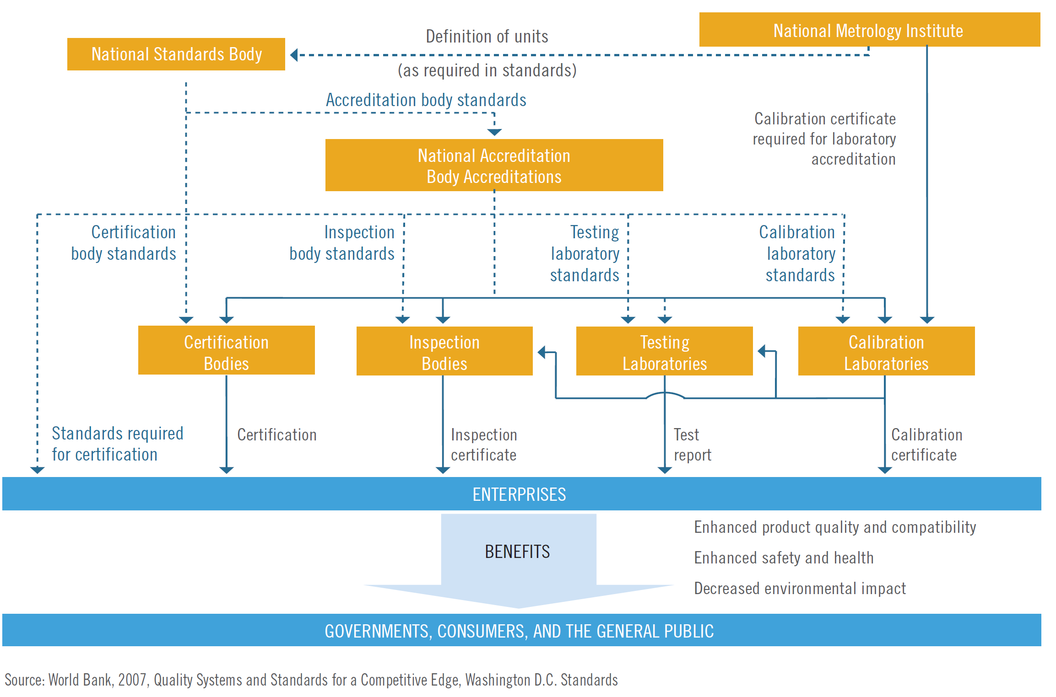
Worldwide Quality Infrastructure
complex processes:
→ Fully digitalized
Grand Vision
SI Digital Framework
Quality Infrastructure
Industry & Health
Science
… a worldwide agreed metadata format for all measurement data
Quality Infrastructure
Industry & Health
Science

Slide 7
SI Digital Framework
A new project „International System of Units (SI) in the digital world”
Established in Session II of the 108th meeting of the CIPM
International Task Group “Digital-SI” of the CIPM started work in November 2019
International Expert Group for recommendations on uniform digital data exchange
Mission of the CIPM Task Group:
World-wide agreed, uniform, unambiguous, authoritative and dependable data exchange framework based on the International System of Units (SI)
Grand Vision
SI Digital Framework
International Workshop FEB 2021
Coordinating this effort with all stakeholders
Suggestions to make the SI Brochure machine readable
In progress by BIPM

Slide 8
“Digital-SI” Team @ Metre Convention
Alan Steele (NRC) retd)
Ryan White (NRC)
Martyn Sené (NPL)
Fedor Bulygin (Rossdandart)
Alistair Forbes (NPL)
James Olthoff (NIST)
Robert Hanisch (NIST)
Pavel Neyezhmakov (NSC)
Stuart Chalk (UNF)
Kazumoto Hosaka (NMIJ)
Martin Milton (BIPM)
Yuning Duan (NIM)
Ismael Castelazo (CENAM retd)
Susanne Picard (BIPM)
Francisco Flamenco (CENAM)
Joachim Ullrich (PTB)
Thomas Liew (A*STAR)
Daniel Hutzschenreuter (PTB)
Blair Hall (MSL)
Héctor Laiz (INTI)
Wynand Louw (NMISA)
Diego Coppa (INTI)
CIPM Task Group members & CIPM support
CIPM Expert Group members
BIPM support: Andy Henson, Romain Coulon, Johanne Flament, Celine Fellag

Slide 9
The Grand Vision: SI Digital Framework

Slide 10
Grand Vision: SI Digital Framework
Grand Vision
SI Digital Framework: Universal metadata models for SI based data the core for interoperable data in QI and science
“The mass of artefact A123 was measured with result 1.000 013 kg, with associated uncertainty U = 0.000 004 kg, k = 2…”
“Artefact A123 was calibrated against reference standard S4 in laboratory L5 by operator O6 using instrument I7 according to measurement procedure P8…“
Orange: Core Information
Blue: Wider knowledge on context

Slide 11
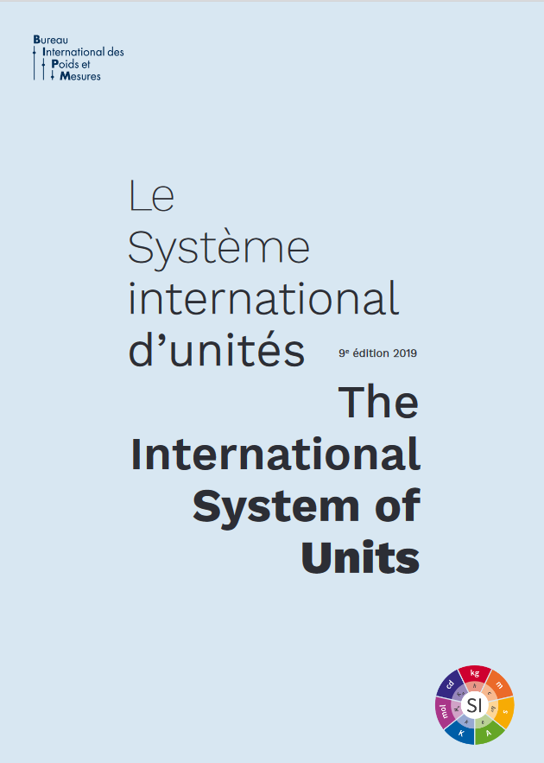
Grand Vision: SI Digital Framework
Sustainable framework for the SI in a digital world
Endorsed by CIPM!
(Decision 109-17)
value, unit, kind of quantity, uncertainty
various data, services and tools
all aligned with FAIR principles
Using Digital Calibration
Certificates
101001001001
Findable
SI-defining Constants
SI, VIM, GUM
Thesauri,
Ontologies, etc.
Accessible
VIM
Interoperable
unit conversion
Reusable
SI Brochure
GUM
Key Comparison
CMCs

Slide 12
The Grand Vision: SI Digital Framework
Immediate start but sustained, long-term effort

Slide 13
The Grand Vision: SI Digital Framework
Second step but sustained, long-term effort

Slide 14
Digital transformation of the SI
→ PTB: Coordination of the CIPM-TG/EG „Digital SI“
22. – 26. February 2021
785 Participants, 1287 Registrations
33 Talks
Representative from
International quality infrastructur
Sience and industry
Lead author of primary FAIR data principles paper
INetQI Chair
Chair DRUM*
Go FAIR Coordinator
CIPM Präsident
CIPM Präsident
ILAC Präsidentin
Digital Publication Manager of ISO
OIML Präsident
CCU Präsident
*DRUM: CODATA Task Group Digital Representation of Units of Measure

Slide 15
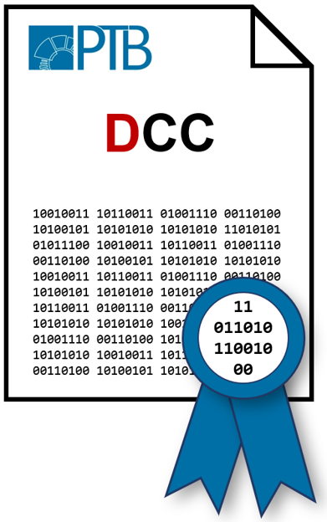
Digital transformation of the SI
→ PTB: Coordination of the CIPM-TG/EG „Digital SI“
22. – 26. February 2021
785 Participants, 1287 Registrations
33 Talks
Representative from
International quality infrastructur
Sience and industry
uniform metadata format for all SI-based measurement data in (international) QI, industry and science:
FAIR: Findable, Accessible, Interoperable, Reuseable + Importance of Traceable
„Grand Vision“:
Results:
CIPM: anchor of trust of international digital QI
Digital Calibration Certificate (DCC): key product

Slide 16
27th CGPM – Planned Resolutions
Resolution A
Evolving Needs in Metrology
Climate, environment, health and life sciences, food safety, energy, advanced manufacturing, digital transformation and countering global pandemics
Multidisciplinary Forum “Metrology & Digitalization”
Resolution B
SI Digital Framework
Extending Metre Convention to globally accepted anchor of trust in digital era;
SI Digital Framework, DCC and FAIR data, NMIs and IOs invited to join effort;
Joint Statement with IOs and Forum

Slide 17
Raodmap
Preparation second workshop
Preparation first workshop
Additional Pilot use-cases
Pilot use-case evaluation
Second workshop Digital-SI
Meeting
Workshop outcome & tech. roadmaps
→ ~15 suggestions so far
EG
Digital-SI
OIML
WS
2021-02 2021-03 2021-04 2021-06 2021-09 2021-10
CIPM/ BIPM
4-year roadmap & resources to establish Digital-SI
First workshop Digital-SI
Meeting
WS D-SI outcomes
→ Suggested activities
Draft Joint Statement
Draft Resolution
Meeting
Draft Statement
Draft Resolution
Monitor Activities
Meeting
November
Meeting
January
Meeting
September
TG
Digital-SI
2022-02 2022-11
Strategy Group Meeting
CIPM Bureau Meeting
Draft Joint Statement
Consequences: Strategy
Draft Resolution
Communication to CIPM
Meeting
Approval Draft Joint Statement
Discussion Draft Resolution
Discuss: Forum D&M
Meeting
Approval Draft Joint Statement
Approval Draft Resolution B
Forum D&M
GCPM
Vote on resolution “SI Digital Framework”
CIPM
Send out documents resolution
Timeline

