Slide 1
First tests of the SIRTI with software live-time correction
C. Michotte, M. Nonis, R. Fitzgerald (NIST)

Slide 2
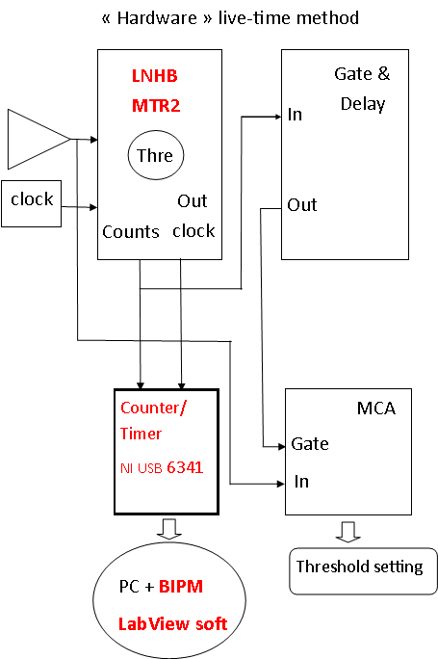
The present SIRTI electronics
MTR2: extended dead-time module with additional features (Bouchard J., ARI 52, 2000, 441)
Dead time of 30 μs
Clock frequency f = 1 MHz (measured, under control)
N_{clock out} number of clock pulses surviving the dead time
N_{counts} number of SIRTI pulses surviving the dead time
Live-time correction is f / (N_{clock out} – N_{counts} f 5 ns)
0.5 μs
1 MHz
10⁻⁴ effect in SIRTI KCs

Slide 3
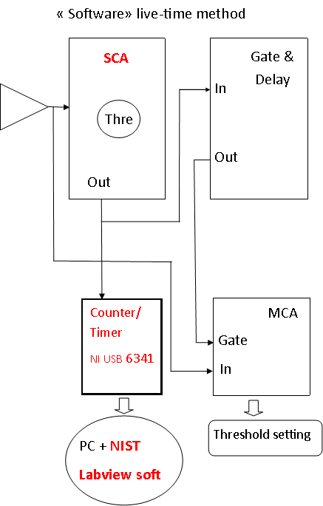
SIRTI electronics, following R. Fitzgerald’s method (ARI 159, 2020, 109101)
Basic commercial modules only
No external clock
NI USB 6341 measures the time difference d between 2 consecutive pulses
Extended dead time of 30 μs
Method:
Additional features of MTR2 are not considered
0.5 μs
200 ns
d
30 μs
Live time
*
* Slightly adapted

Slide 4
Results at NIST
R. Fitzgerald developed the LabView software for the NI6341
He compared the results with NIST reference live-time module and found agreement within 2 x 10⁻⁴

Slide 5
Comparison of SIRTI measurements using RF’s method or the MTR2 (in progress)
Threshold set with the Nb-93m x-ray peak between the measurement series
Extended dead-time of 30 μs
RN | MTR2 live rate / s⁻¹ | Dead-time / % | Meas. duration | NIST soft live rate / s⁻¹ | Dead-time / % | Meas. duration | Relative diff. / 10⁻⁴
Bg | 76.23(15) | 0.24 | 10x300 s | 75.94(18) | 0.23 | 5x600 s | 38(31)
⁵⁷Co | 5666.2(13) | 16 | 10x500 s | 5664.20(46) | 16 | 5x2000 s | 3.6(25)
⁹⁴Nb | 7590.6(22) | 22 | 10x300 s | 7589.06(73) | 20 | 5x600 s | 2.0(30)
⁹⁴Nb | 7589.3(14) | 22 | 10x700 s | 7589.30(87) | 20 | 5x1400 s | 0.0(21)
⁶⁰Co | 24 858.0(30) | 55 | 10x500 s | 24 848.4(15) | 53 | 5x2000 s | 3.9(14)
NIST software seems systematically lower than MTR2 by less than 4 x 10⁻⁴; no dependence observed versus rate
To be compared with ⁹⁴Nb in SIRTI long-term repeatability of 2.5 x 10⁻⁴
More measurements needed
BIPM version of NIST software in development

Slide 6
Many thanks to R. Fitzgerald, NIST, for the LabView software and C. Bobin, LNE-LNHB, for providing the MTR2 modules for the SIRTI

